Slide 1
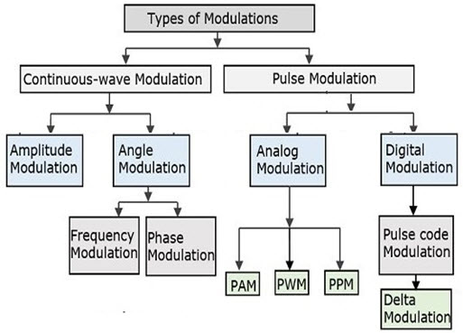
Modulation Techniques

Slide 2
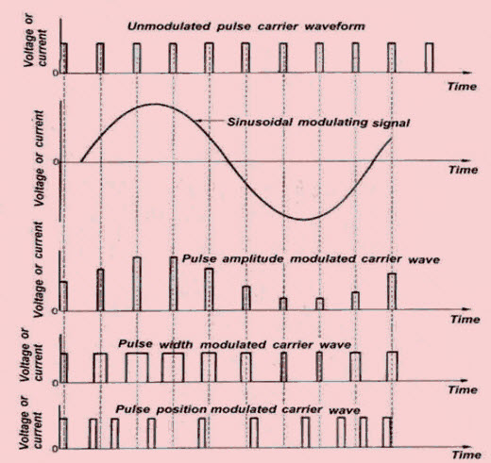
Comparison of Pulse mofulation

Slide 3
Comparison of Pulse mofulation
Sr. No. | Parameter | PAM | PWM | PPM
1 | Type of Carrier | Train of Pulses | Train of Pulses | Train of Pulses
2 | Variable Characteristic of the Pulsed Carrier | Amplitude | Width | Position
3 | Bandwidth Requirement | Low | High | High
4 | Noise Immunity | Low | High | High
5 | Information Contained in | Amplitude Variations | Width Variations | Position Variations
6 | Power efficiency (SNR) | Low | Moderate | High
7 | Transmitted Power | Varies with an amplitude of pulses | Varies with variation in width | Remains Constant
8 | Need to transmit synchronizing pulses | Not needed | Not needed | Necessary
9 | Bandwidth depends on | Bandwidth depends on the width of the pulse | Bandwidth depends on the rise time of the pulse | Bandwidth depends on the rise time of the pulse
10 | Transmitter power | Instantaneous transmitter power varies with the amplitude of the pulses | Instantaneous transmitter power varies with the amplitude and width of the pulses | Instantaneous transmitter power remains constant with the width of the pulses
11 | The complexity of generation and detection | Complex | Easy | Complex
12 | Similarity with other Modulation Systems | Similar to AM | Similar to FM | Similar to PM

Slide 4
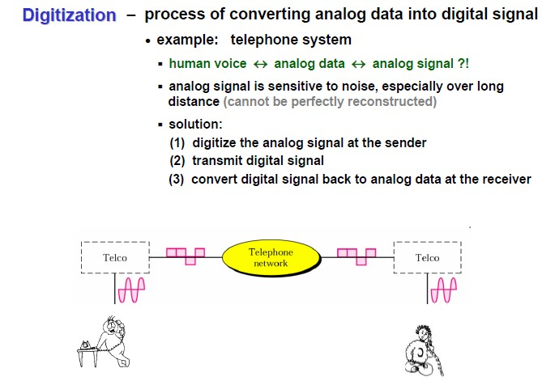
Digital Transmission of Analog signal

Slide 5
Application of pulse modulation
Application of Pulse Amplitude Modulation
Ethernet Connectivity for Broadband interface communication
To control signals in Micro-controllers
Graphics card for high-speed networking and reduce the noise to signal ratio.
In Photo Biology for the purpose of spectrofluorometric measurements during photosynthesis
For energy-efficient lighting in LED drivers
For better signal clarity and clearer picture in Digital Televisions
Application of PWM
the PWM is commonly used to control the speed of electric motors, the brightness of lights, in ultrasonic cleaning applications, and many more.
PWM (Pulse Width Modulation) is used to control electric power inside the motor coil. The output power is controlled by repeatedly turning the output ON and OFF. Constant voltage operates the motor with the constant period of the pulses. Used in IoT Drive buzzer with different loudness.
Control speed of the motor.
Control the direction of a servo.
Provide an analog output.

Slide 6
Application of pulse modulation
Applications of PPM:
It is utilized in air traffic control and telecommunications networks.
Pulse code modulation is used in remote-operated autos, planes, and trains.
It is used to compress data and, therefore, for storage.

Slide 7
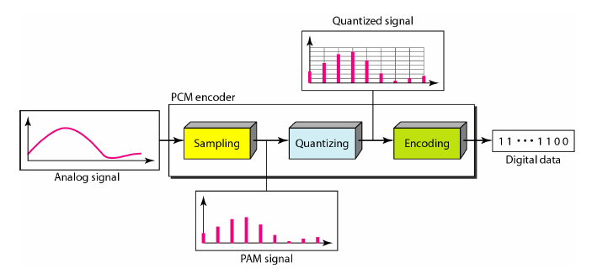
Digital Transmission of Analog signal

Slide 8
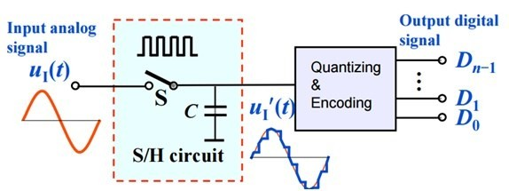
Digital Transmission of Analog signal

Slide 9
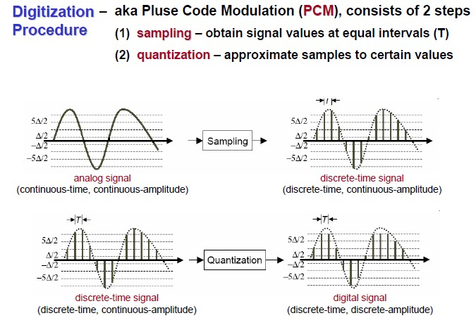
Digitization

Slide 10
Pulse Code Modulation (PCM)
Analog voice data must be translated into a series of binary digits before they can be transmitted.
With Pulse Code Modulation (PCM), the amplitude of the sound wave is sampled at regular intervals and translated into a binary number.
The difference between the original analog signal and the translated digital signal is called quantizing error.

Slide 11
Pulse Code Modulation (PCM)
PCM uses a sampling rate of 8000 samples per second.
Each sample is an 8 bit sample resulting in a digital rate of 64,000 bps (8 x 8000).

Slide 12
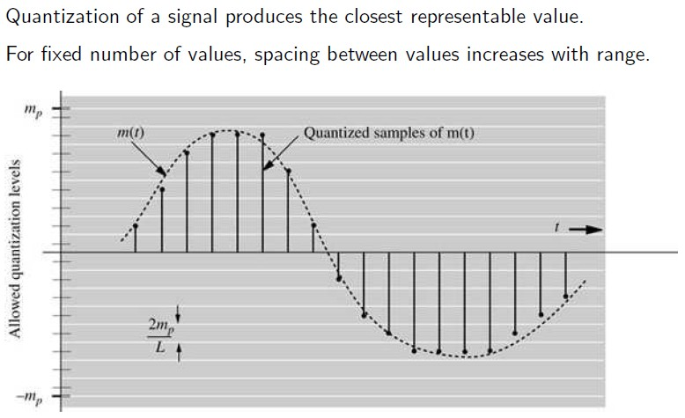
Quantization

Slide 13
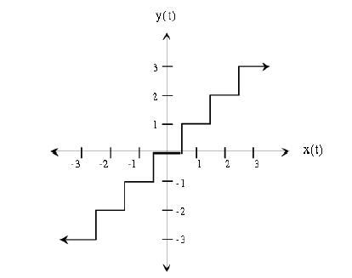
Uniform Quantization

Slide 14
Quantization
The process of measuring the numerical values of the samples and giving them a table value in a suitable scale.
The finite number of amplitude intervals is called the ‘quantizing interval’ like quantizing interval no.1 is 10-20mV; 2 is 20-30mV etc. in a case of 1V signal.
Linear quantizing is where the quantizing intervals are of the same size

Slide 15
Quantization
Quantization intervals are coded in binary form, and so the quantization intervals will be in powers of 2.
In PCM, 8 bit code is used and so we have 256 intervals for quantizing (128 levels in the positive direction and 128 levels in negative direction)

Slide 16
Quantization Error
The deviation between the amplitude of samples at the transmitter and receiving ends.
In linear quantization, the distortion is more and to decrease the distortion, the no. of steps in the given amplitude range has to be increased.
Due to BW limitations, more quantum levels in small amplitude region are planned results to, Non linear (uniform) quantization

Slide 17
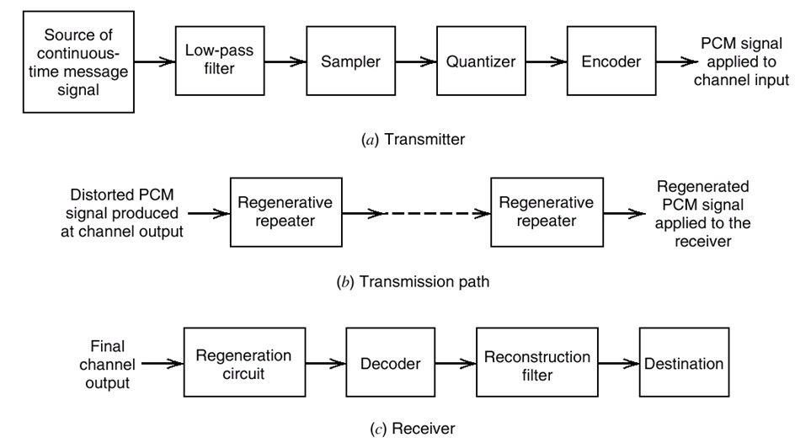
PCM Transmission System

Slide 18
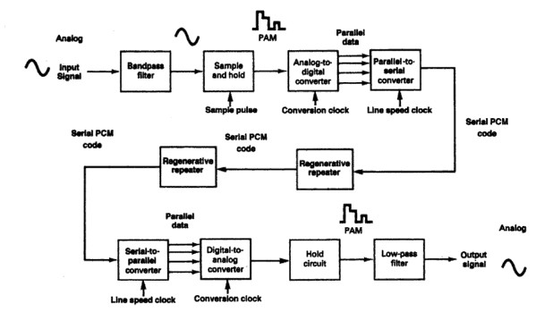
PCM Transmission System

Slide 19
Companding
Is the process where non uniform quantization is achieved using segmented quantization.
Companding is the process of compressing and them expanding.
With companded systems, the higher-amplitude analog signals are compressed (amplified less than the lower-amplitude signals) prior to transmission.

Slide 20
Companding
Non-uniform quantizers are difficult to make and expensive.
An alternative is to first pass the speech signal through a nonlinearity before quantizing with a uniform quantizers.
The nonlinearity causes the signal amplitude to be
Compressed.
  The input to the quantizers will have a more uniform distribution.

Slide 21
Companding
 At the receiver, the signal is Expanded by an inverse to the nonlinearity.
 The process
of compressing and expanding is called
Companding.

Slide 22
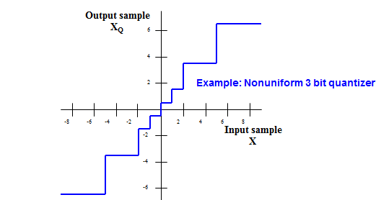
Companding
It is then expanded (amplified more than the lower- amplitude signals) in the receiver.
Companding is the means of improving the dynamic range of communications system.

Slide 23
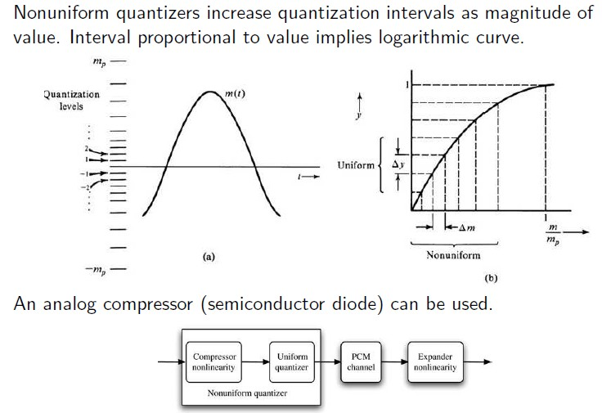
Non-Uniform Quantization

Slide 24
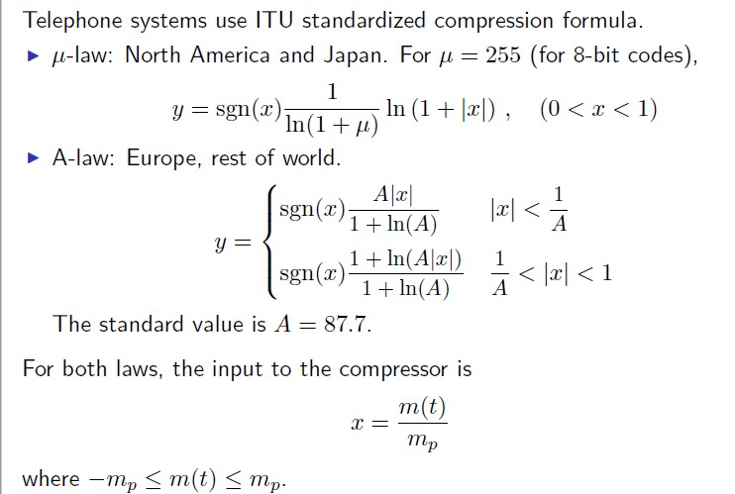
Non-Uniform Quantization

Slide 25
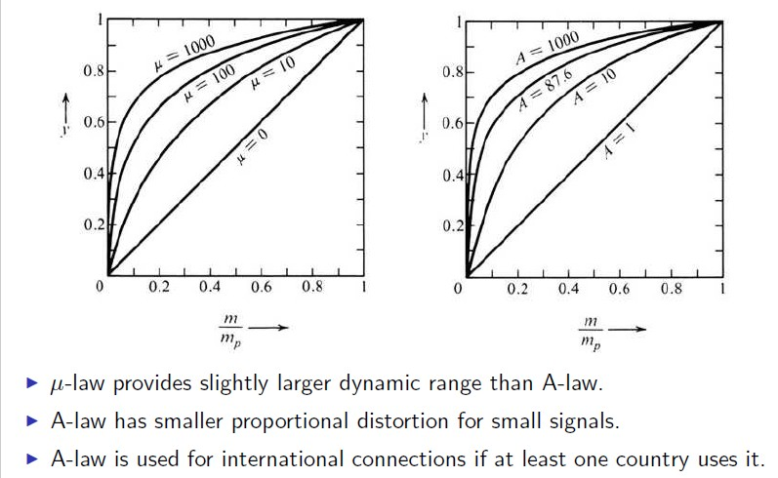
µ-Law and A-Law Companding

Slide 26
